Slide 1
Enhance visitor experience and researcher productivity by leveraging machine intelligence
Stinger Inspector - Team UBS February 2018
This document is for informational purposes only and is not intended to be construed as an invitation or offer of securities or to conclude a contract or to buy and sell any security or related financial instrument.
The facts and opinions presented are those of the author only and not official opinions of UBS

Slide 2
Enhancing Experience and Productivity
Goals:
Find appealing stinger pictures to show visitors
Scale manual researcher stinger classification to large number of pictures automatically
Validate researcher classification for scientific accuracy
Find new categories of stingers for researcher and visitors to explore

Slide 3
Find Appealing Displays
Objective: find clean images for visitors to see core features clearly
Challenge: many pictures in many folders, which ones to pick
Solution: scan through all folders find images with little absolute change
Clean
Noisy

Slide 4
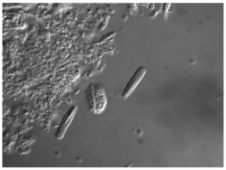
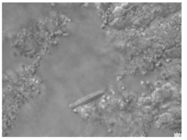
Scale manual researcher classification
Objective: automatically classify stinger types on unseen images
Challenge: many noisy pictures
Solution: train deep neutral networks, achieved 70% accuracy
Correct Type A
Correct Type B

Slide 5
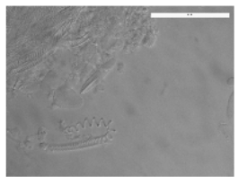
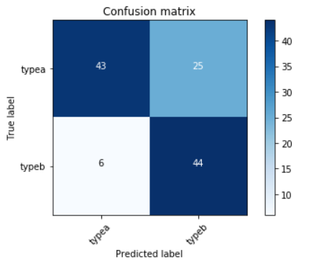
Validate Work / Find New Categories
Objective: did the researcher miss anything? Are there other categories?
Challenge: many stingers look similar to the human eye
Solution: identified cluster of stingers which get consistently misclassified
Confusion Matrix
Example

Slide 6
Our Workflow
Preprocess
Model
Modify pre-trained resnet34
Infra-structure
Stack: Pyhon PIL, CV2, pytorch, fastai
Greyscale
0-1 normalize
Convolutional Neural Network (CNN)
Preparation
Course.fast.ai
Kaggle Right Whale Challenge
Hardware: Paperclip cloud gpu

Slide 7
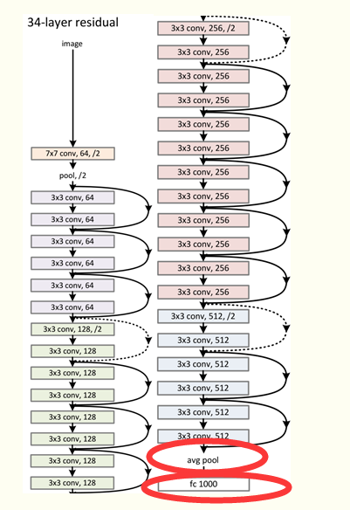
Our Learnings - What worked
Pretrained deep CNN easily adopted for other purposes
Image greyscale and normalization increased accuracy from 63% to 70%

Slide 8
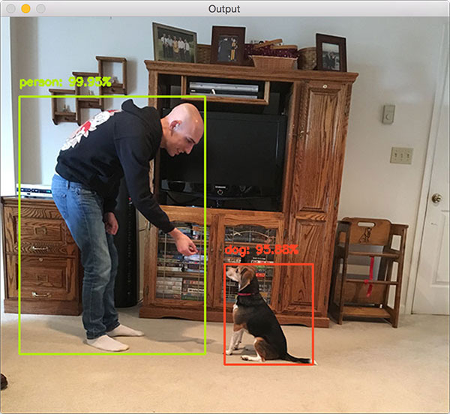
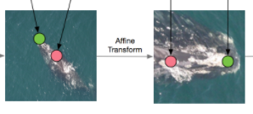
Our Learnings - What didn’t work (fast)
Tried to leverage human drawn image focus and alignment areas shapes differ and multiple objects
Tried to leverage object detection but confused by different shapes and multiple objects
Training auto crop model
Training auto alignment model
Training auto detection model

Slide 9
Objectives
Find appealing pictures to display
Scale manual researcher classification to large number of pictures automatically
Validate researcher work for scientific accuracy
Find new categories of stingers for researcher and visitors to explore

